Slide 1



WELCOME
Welcome to TMedia Business Solution, where we deliver innovative solutions to meet your unique needs.
Edification - Powered by TMBS
Notes:
Comprise of 30 plus modules considering every stake holders in education system.

Slide 2

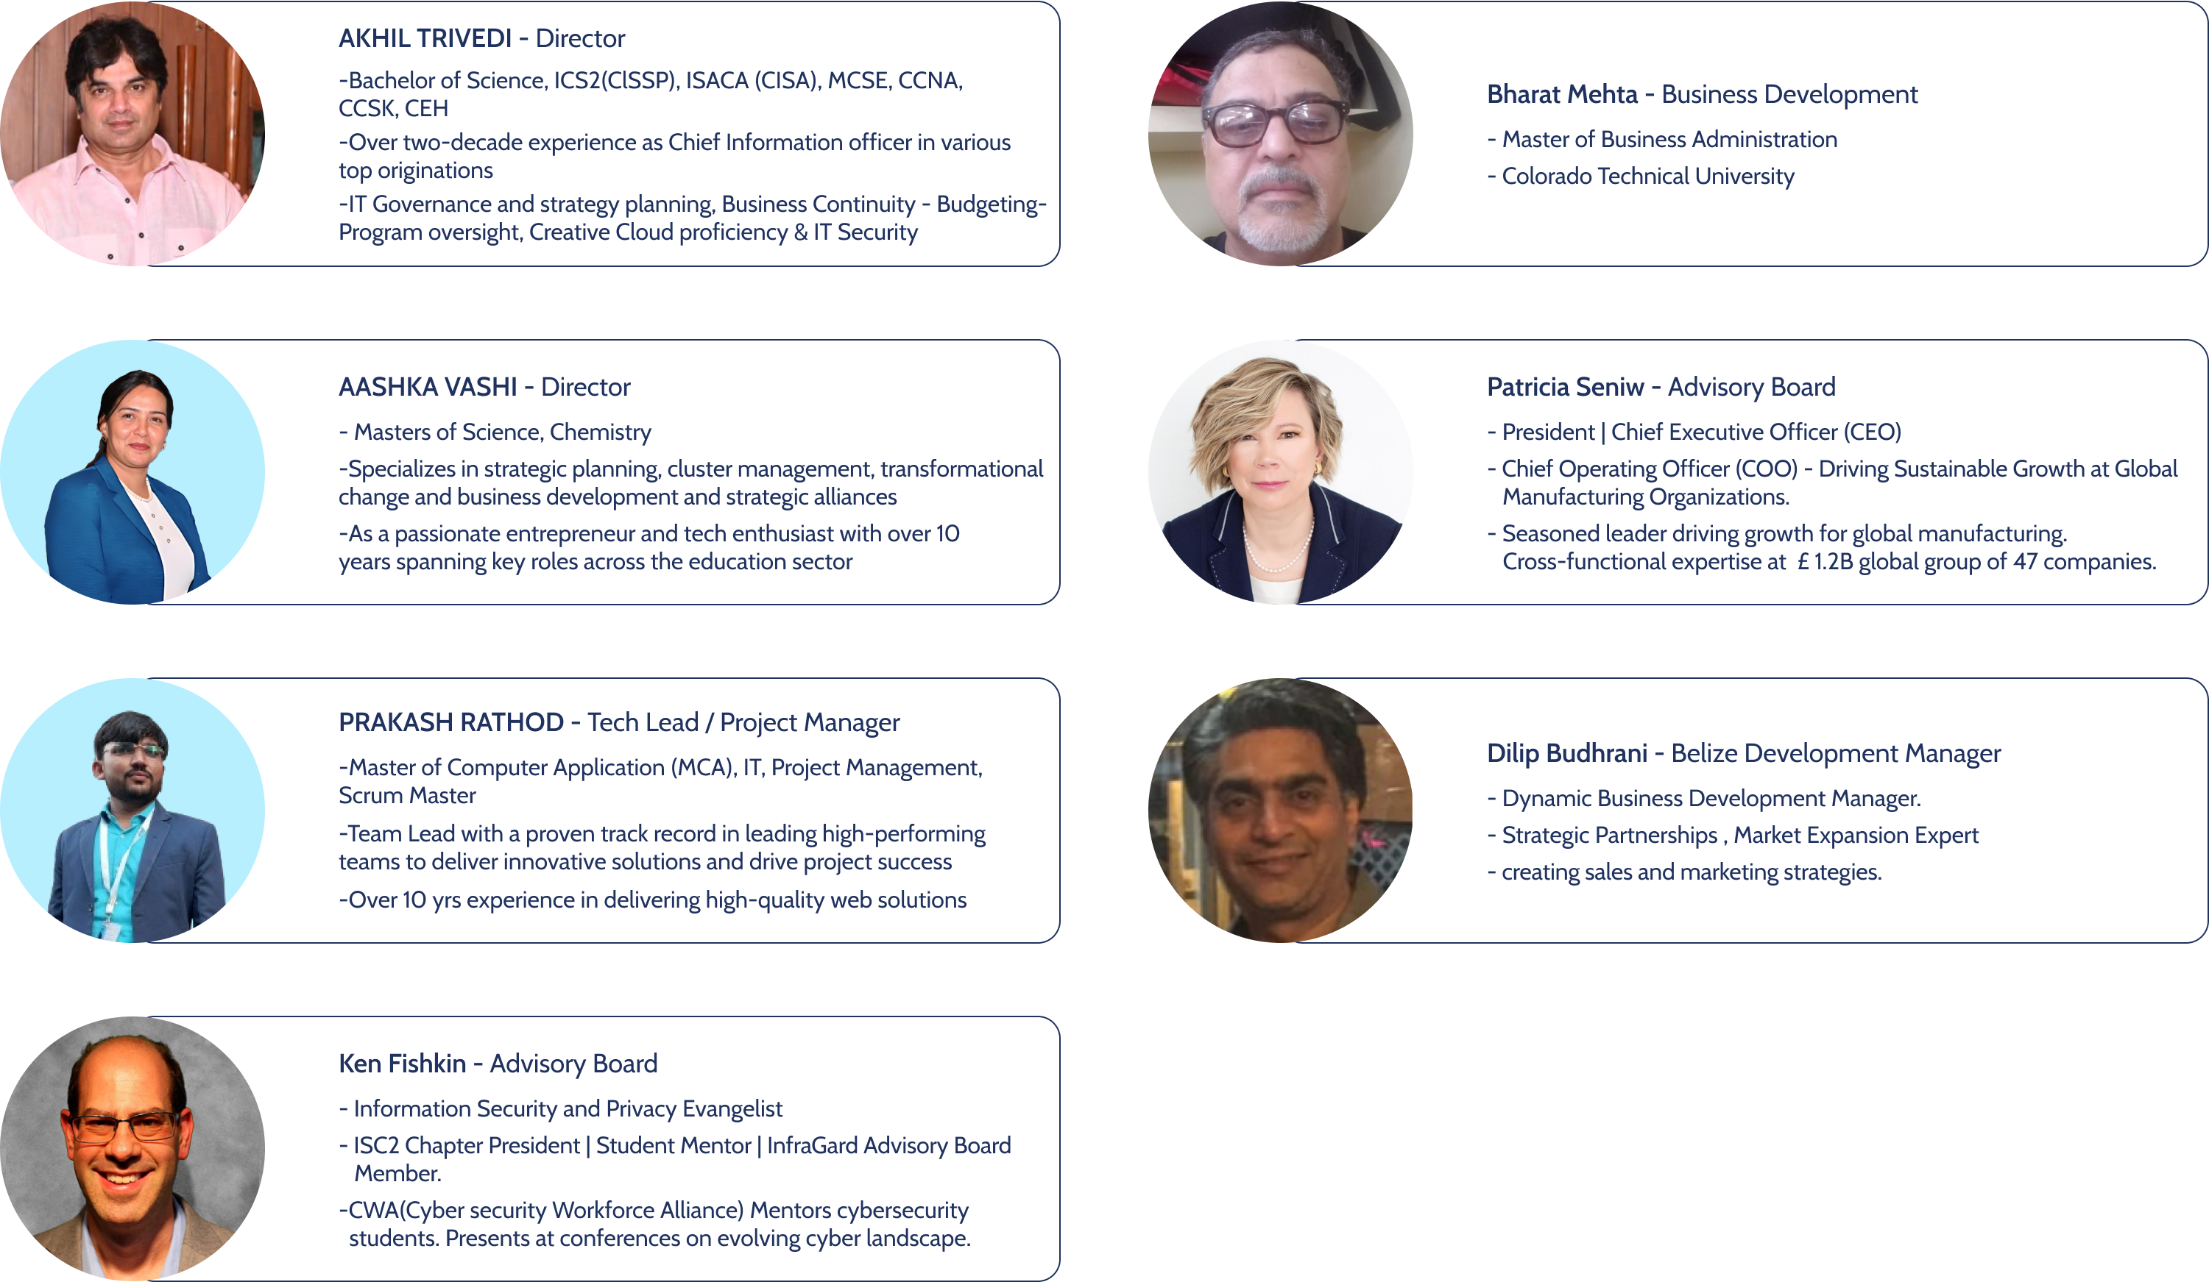

Our Team

Slide 3
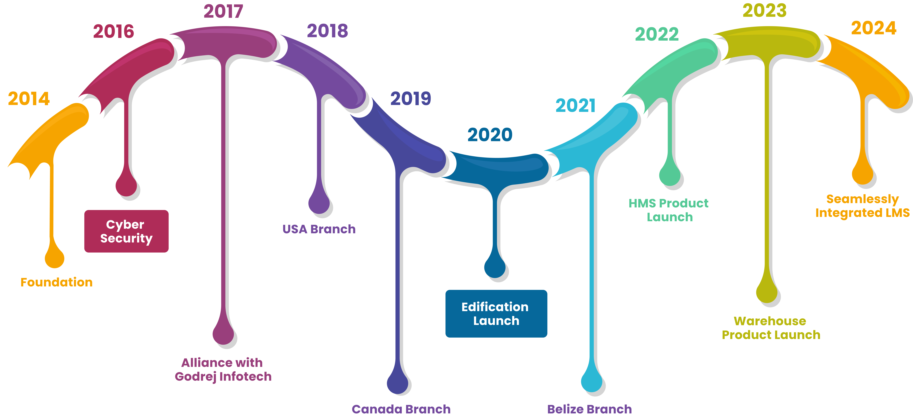
Our Roadmap
Notes:
Talk about three pillars

Slide 4


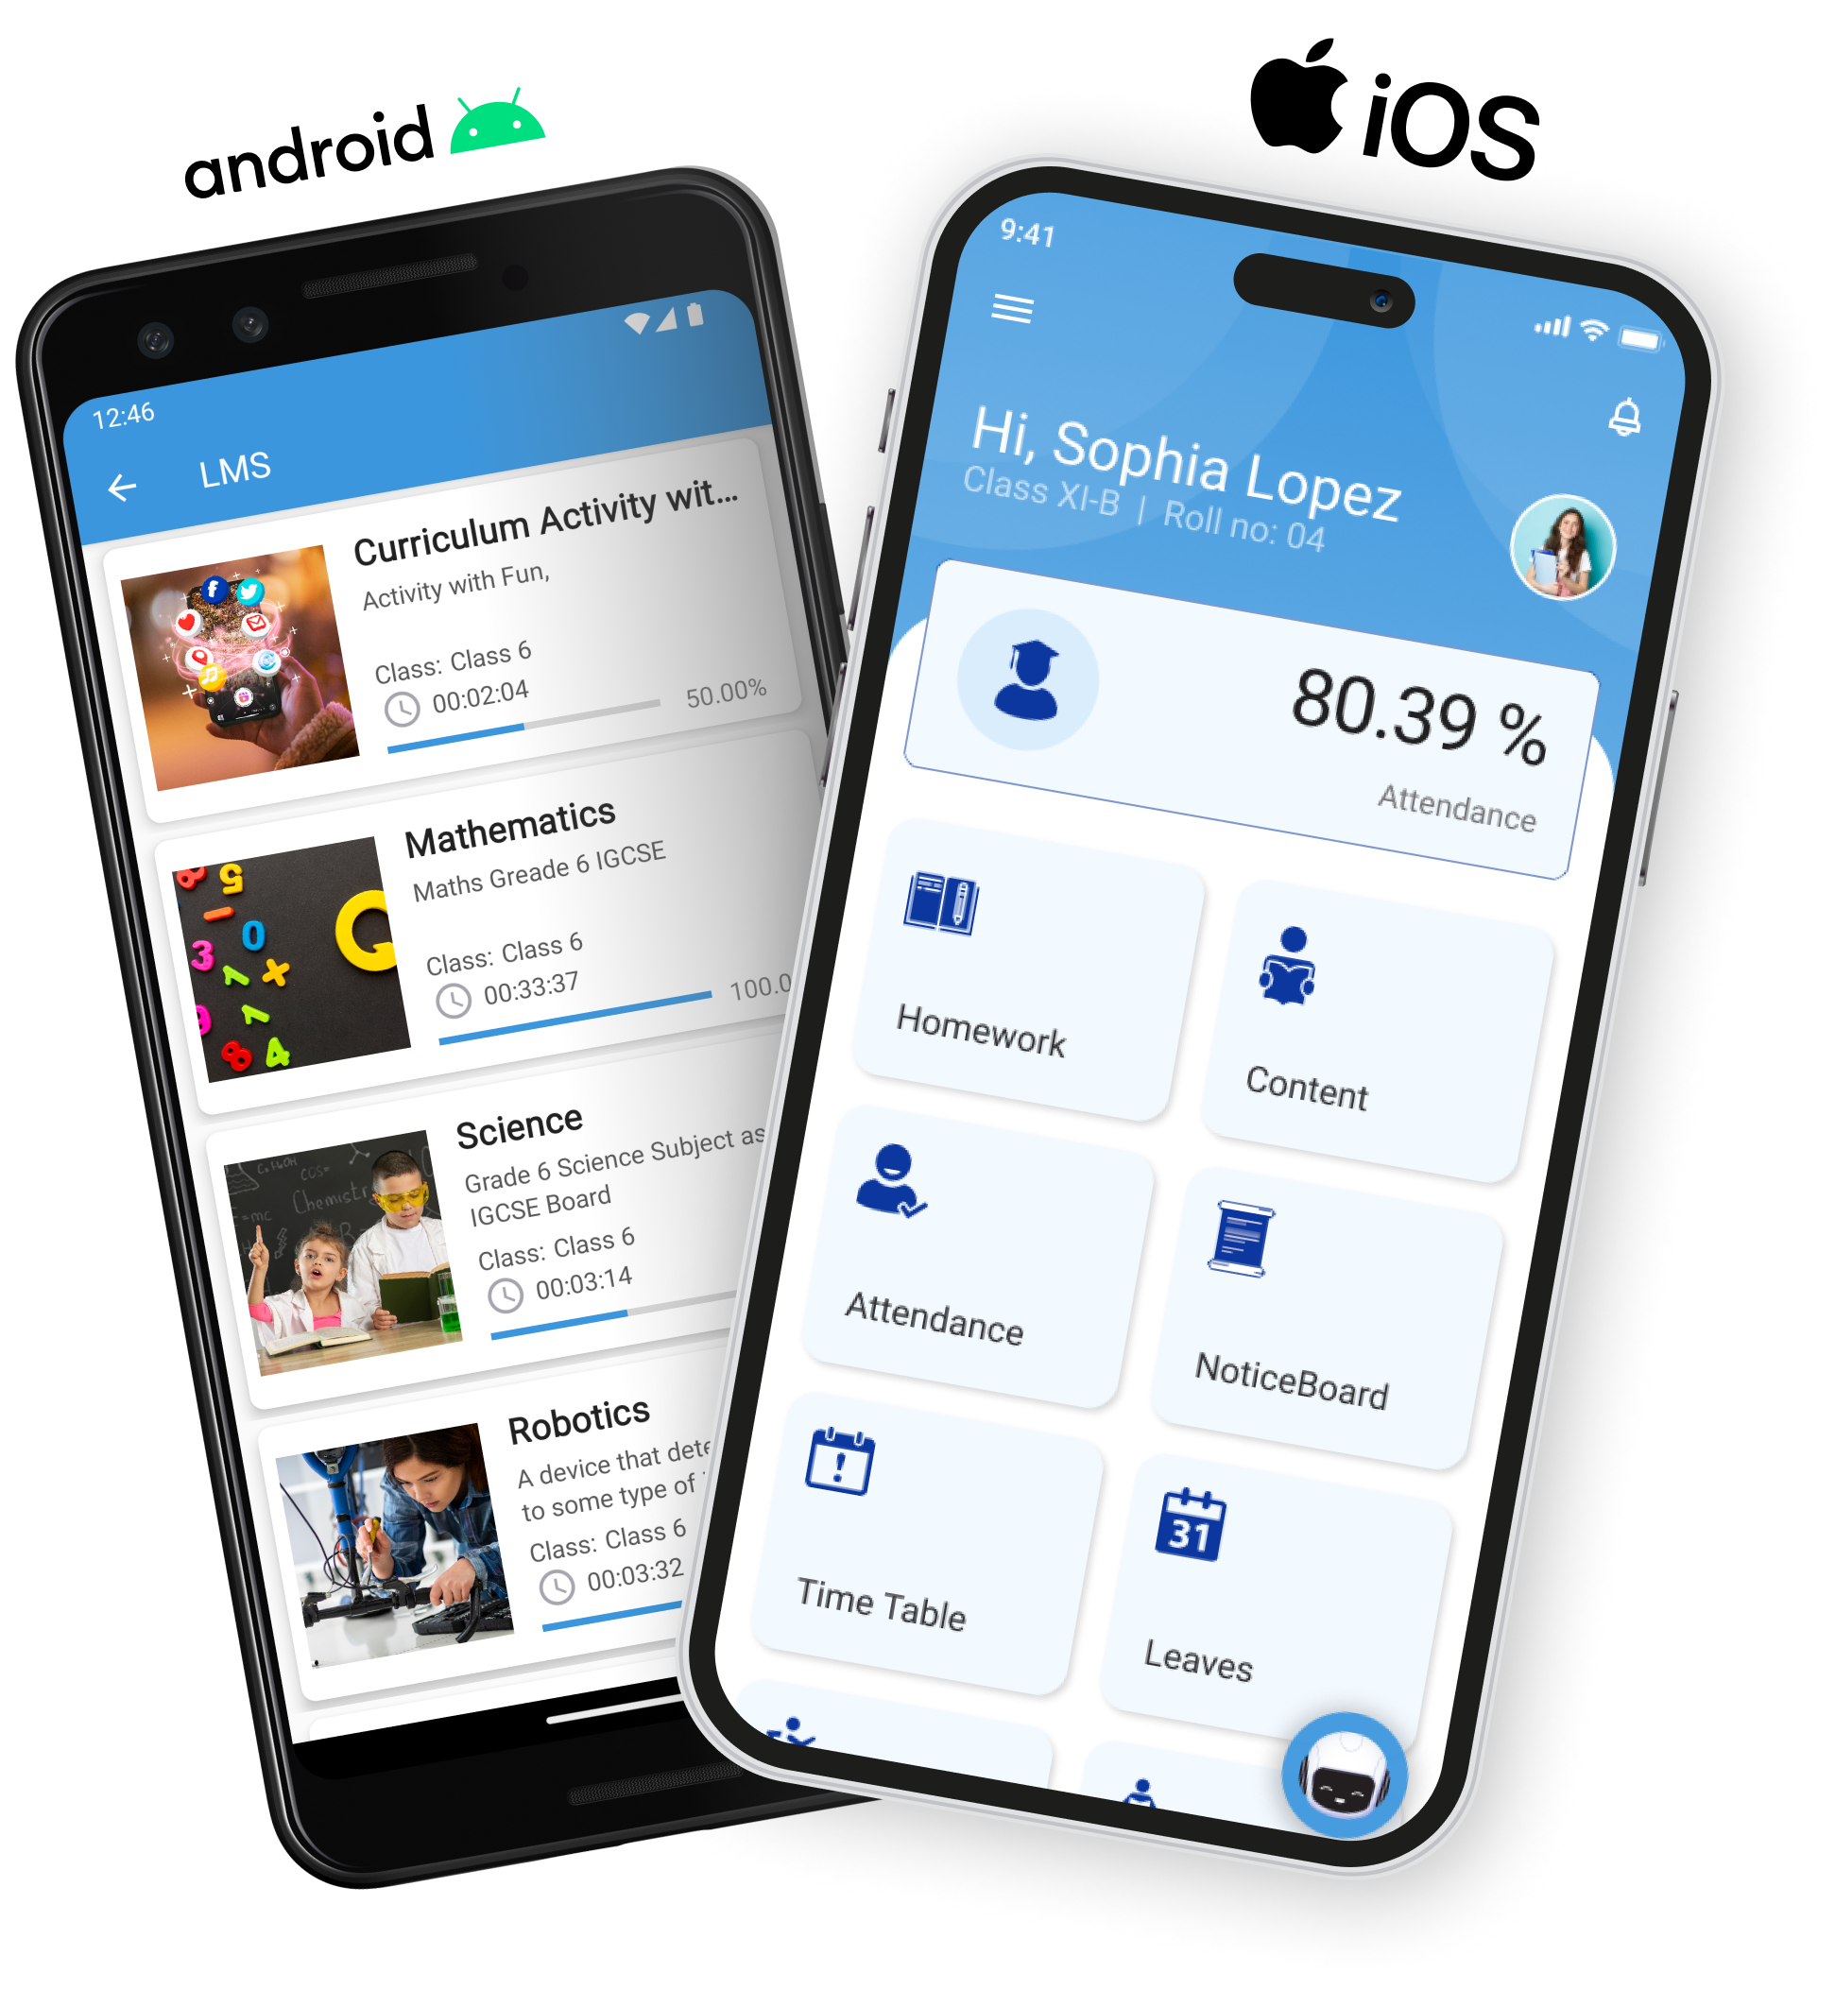
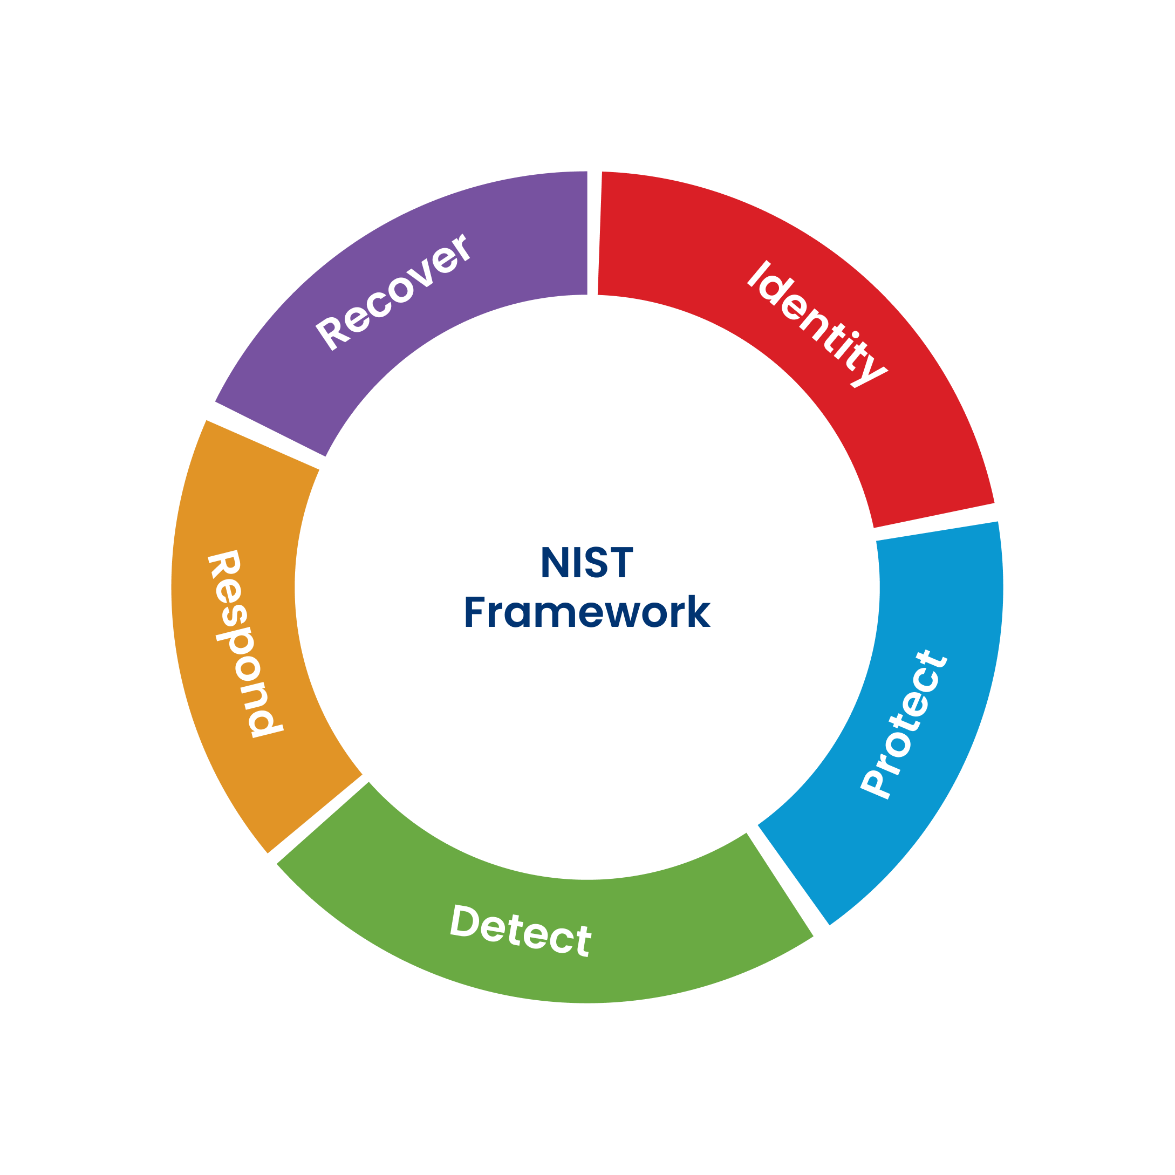
Digitizing the entire Education Process A Complete ERP+LMS Software Solutions
Elevating Educational Standards: A Technological Leap Forward Securing Organization
Cloud Based ERP with LMS
Risk Analysis (NIST-CIS-COBIT-CFS)
Notes:
Comprise of 30 plus modules considering every stake holders in education system.

Slide 5








Edification and LMS design to include all Stake Holders
Financial
Institutions
Parents
Government
Students
Community
Teachers

Slide 6
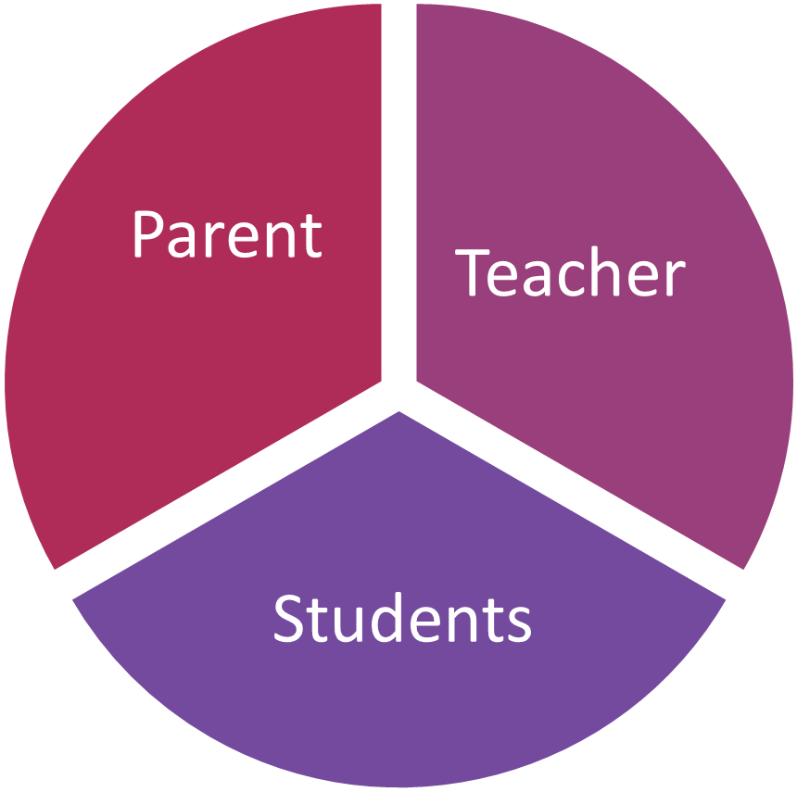
Empowering Stakeholders - Holistic Approach
“we aim to empower students, teachers, principals, administrators, and parents at both district and state levels. ”
Stakeholder Perspectives: Comprehensive support
Teachers' Outlook for Student
Parents' Views on Progress
Children's Aspirations and Futures
Enhanced Student Outcomes
Student Performance Analytics
Data Driven Approach:
Centralized Data Management
Personalized Learning Plans
Teacher Performance and Professional Development
Resource Optimization
Attendance and Behavior Monitoring
Compliance and Reporting
Predictive and Prescriptive Insights
Seamless Integration with Adaptive Instruction Software
Notes:
Benefit every participant within the education system. With targeted interventions, we aim to empower students, teachers, principals, administrators, and parents at both district and state levels. By aligning our efforts with their individual learning and developmental goals, we foster a collaborative environment that ensures accountability and continuous improvement.

Slide 7

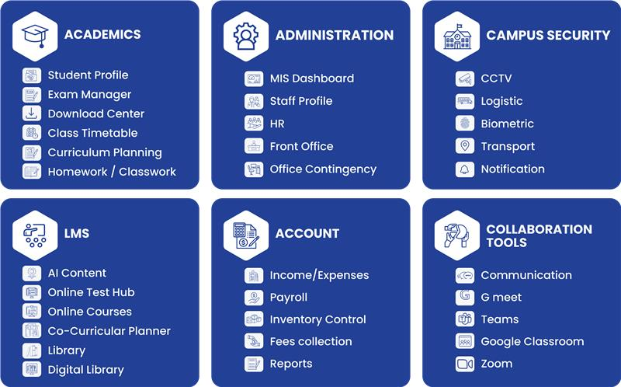
Our Software Solutions

Slide 8
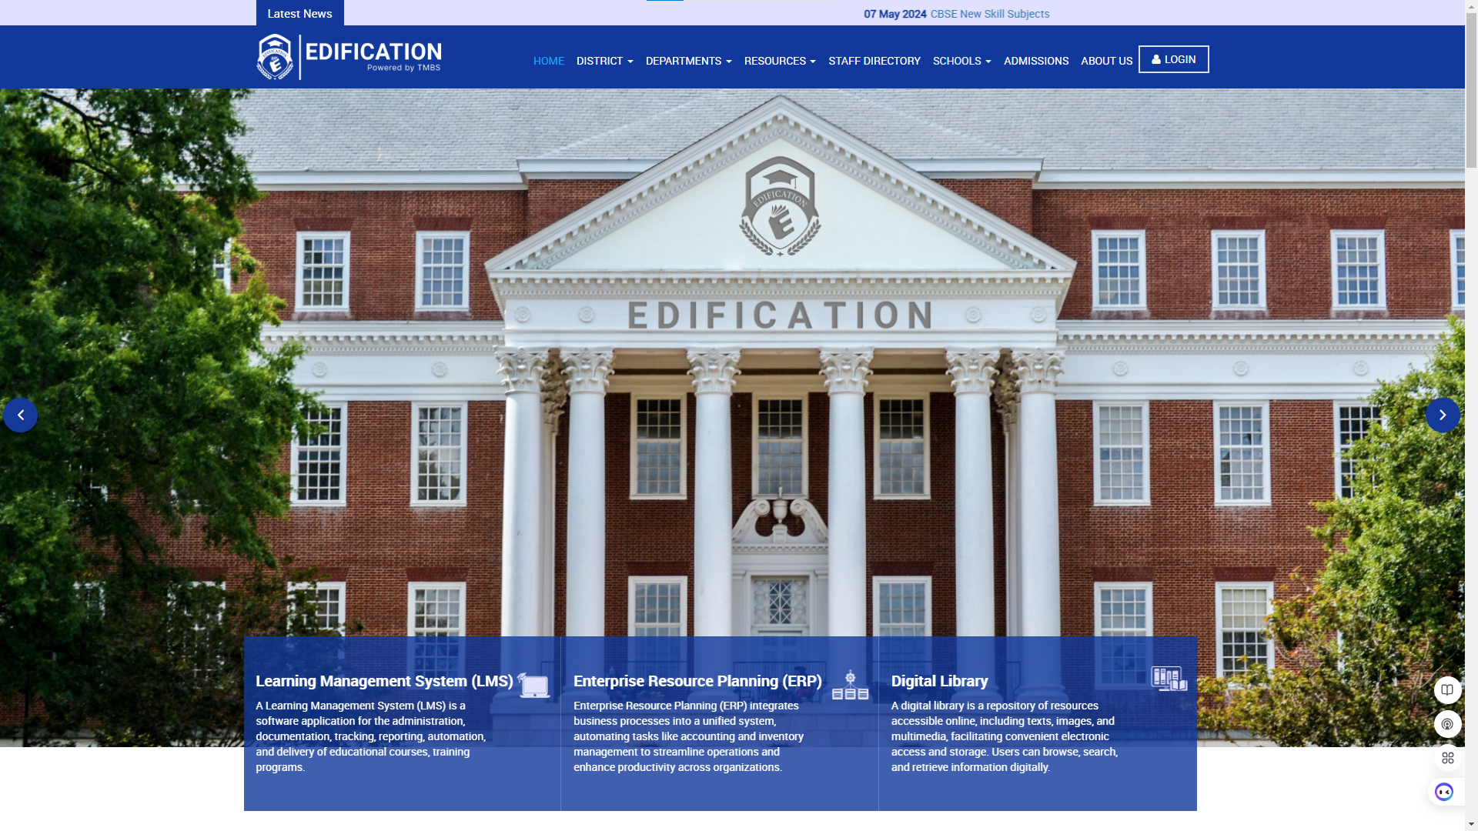
Click Here
Click here to login
Notes:
Benefit every participant within the education system. With targeted interventions, we aim to empower students, teachers, principals, administrators, and parents at both district and state levels. By aligning our efforts with their individual learning and developmental goals, we foster a collaborative environment that ensures accountability and continuous improvement.

Slide 9
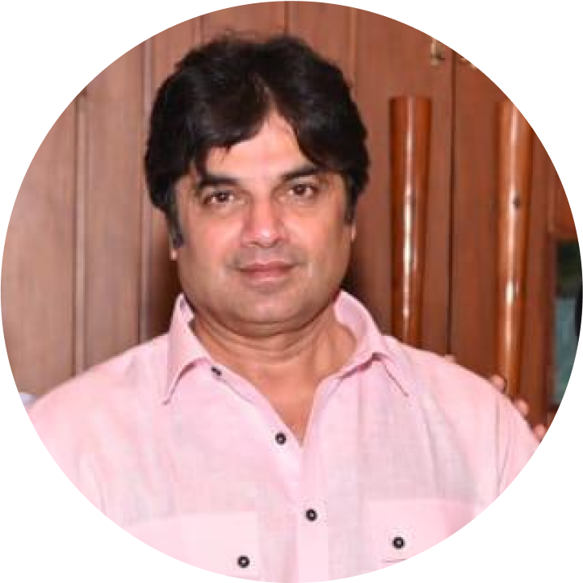
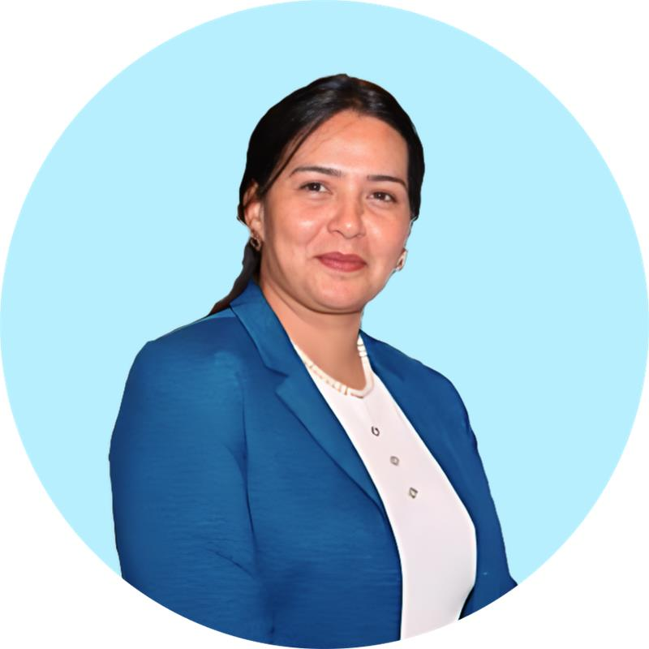

Ask Us
Anything
?
?
We’re here to help. Share your queries, and let’s discuss!
Akhil Trivedi - Director
Email:at@tmbsusa.com
Phone:(908) 334-4476
Aashka Vashi - Director
Email: aashka@tmediabusinesssolution.com
Phone:+91 9712991815
Bharat Mehta - Business Development
Email:bharat@tmediabusinesssolution.com
Phone:(609) 721-3789

Slide 10
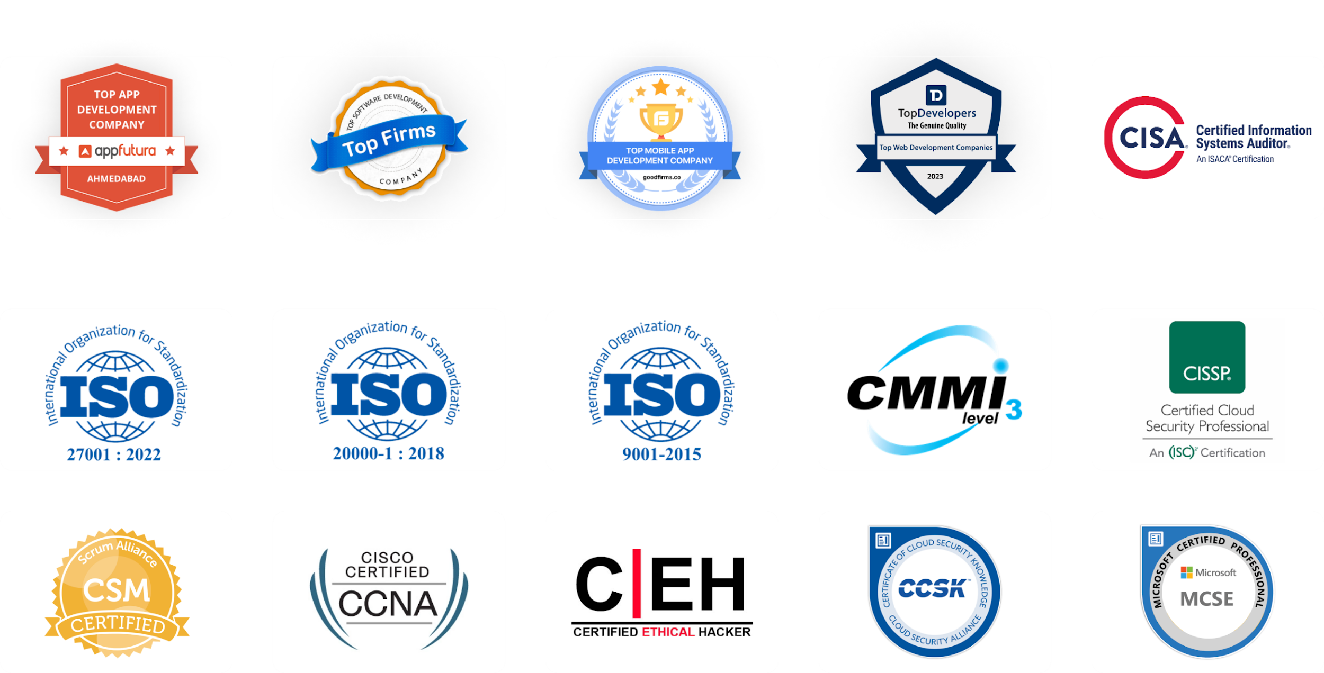
Honors and Certifications: Recognizing Excellence
Thank You

