Slide 1


Slide 2
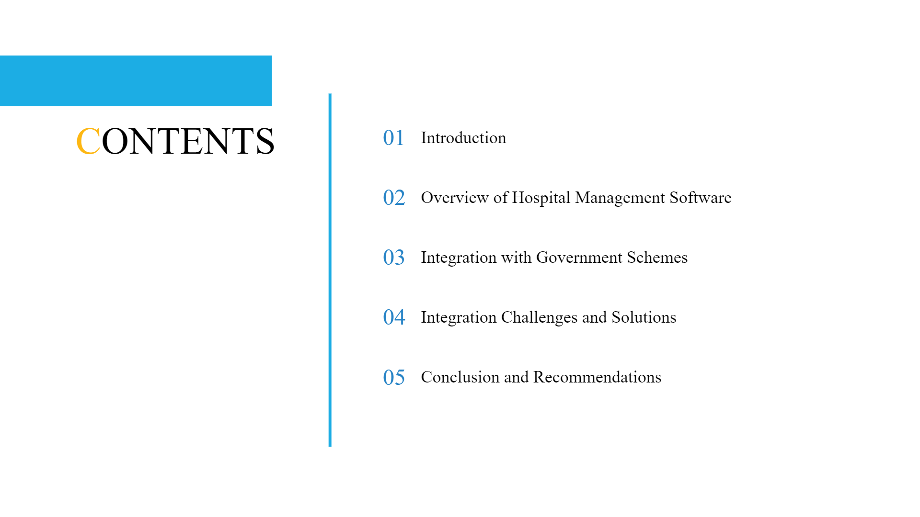

Slide 3


Slide 4



Hospital Management System.
Integrates and facilitates different types of user accounts.
Super Admin
Nurse
Doctor
Patient
Pharmacist
Receptionist
Laboratory
Admin

Slide 5
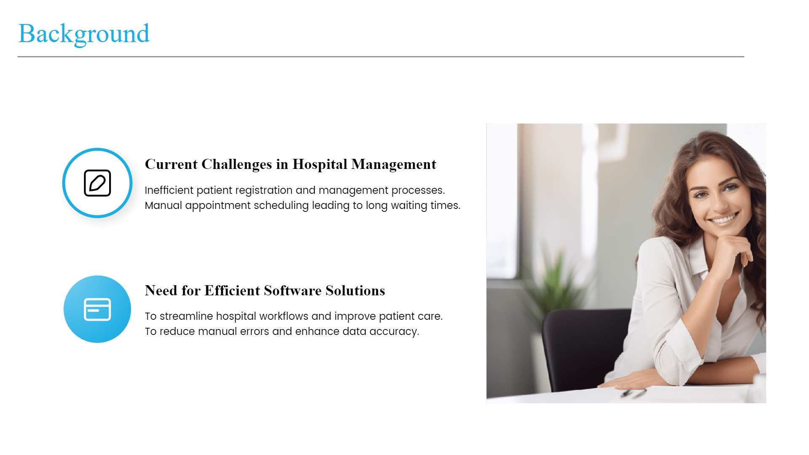

Slide 6
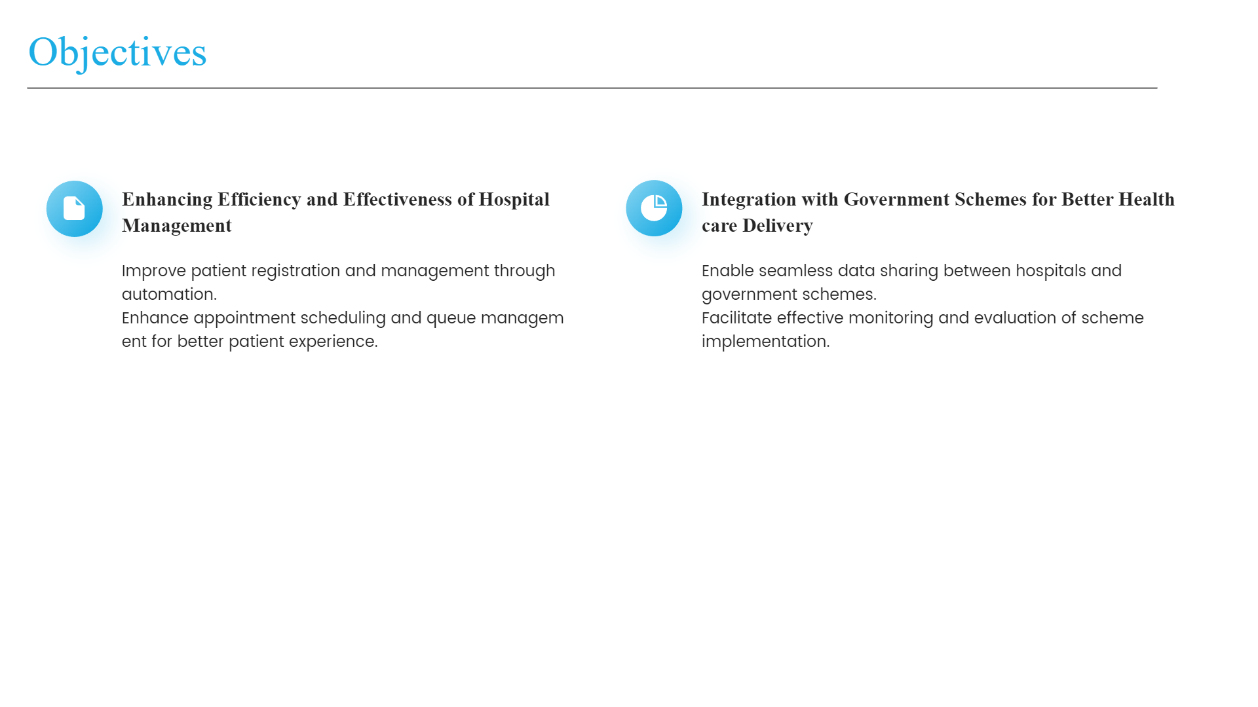

Slide 7
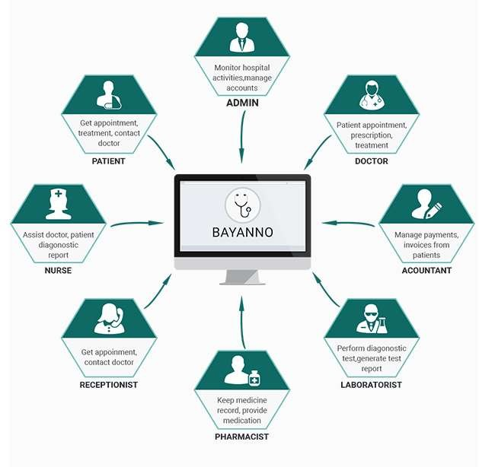
Hospital Management System

Slide 8


Slide 9
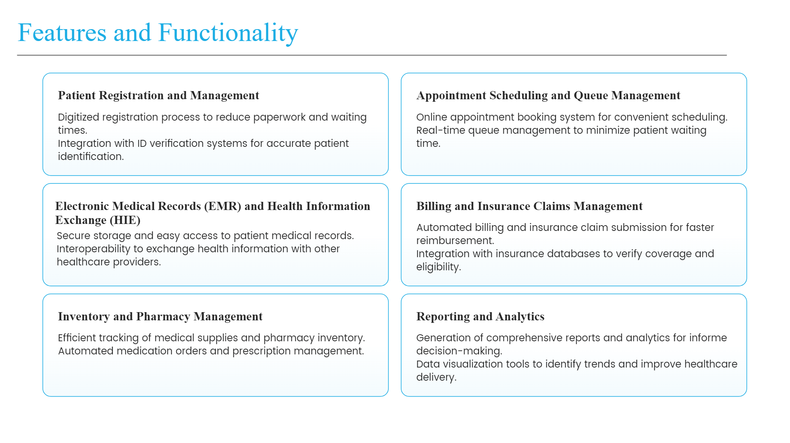

Slide 10
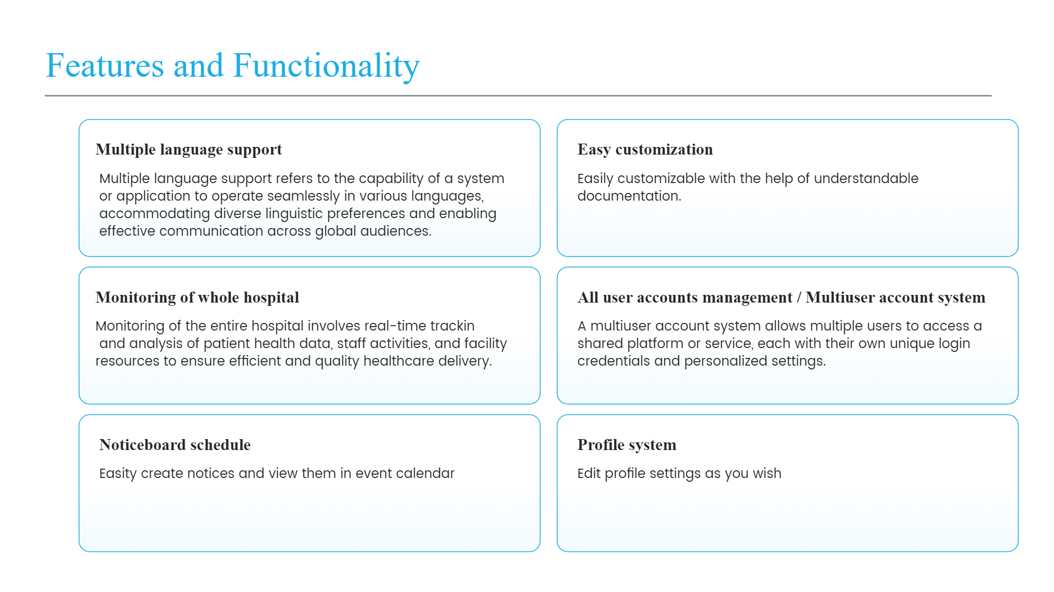

Slide 11
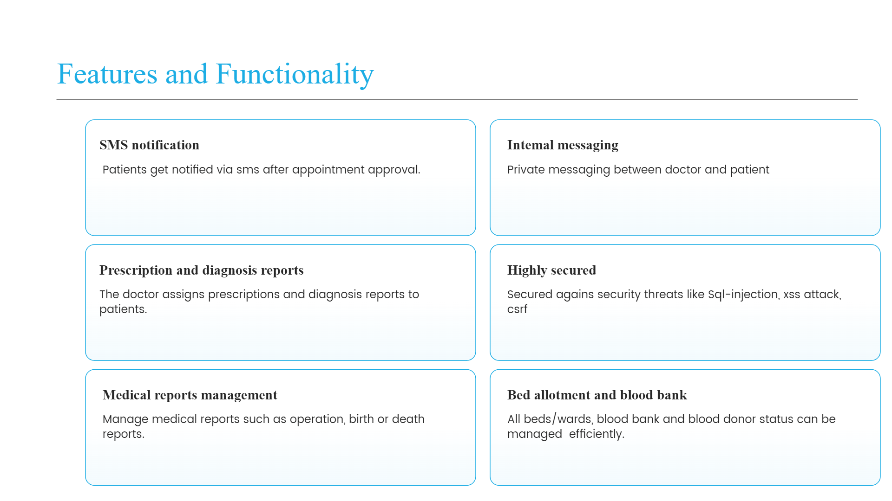

Slide 12
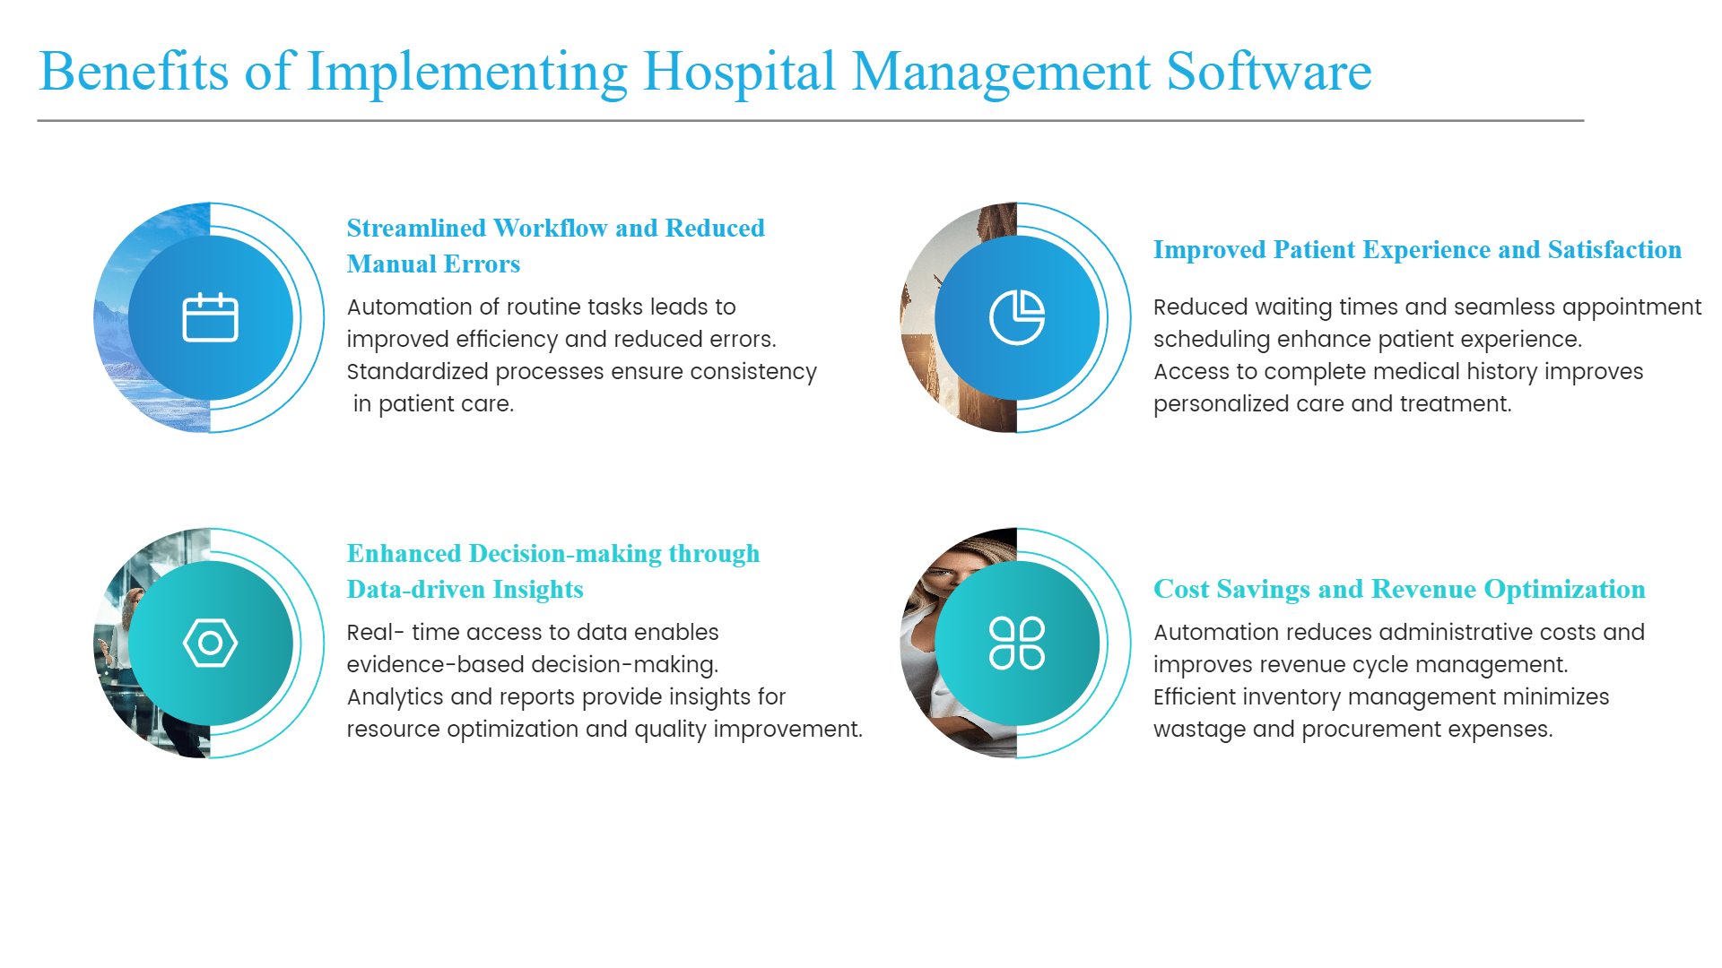

Slide 13


Slide 14
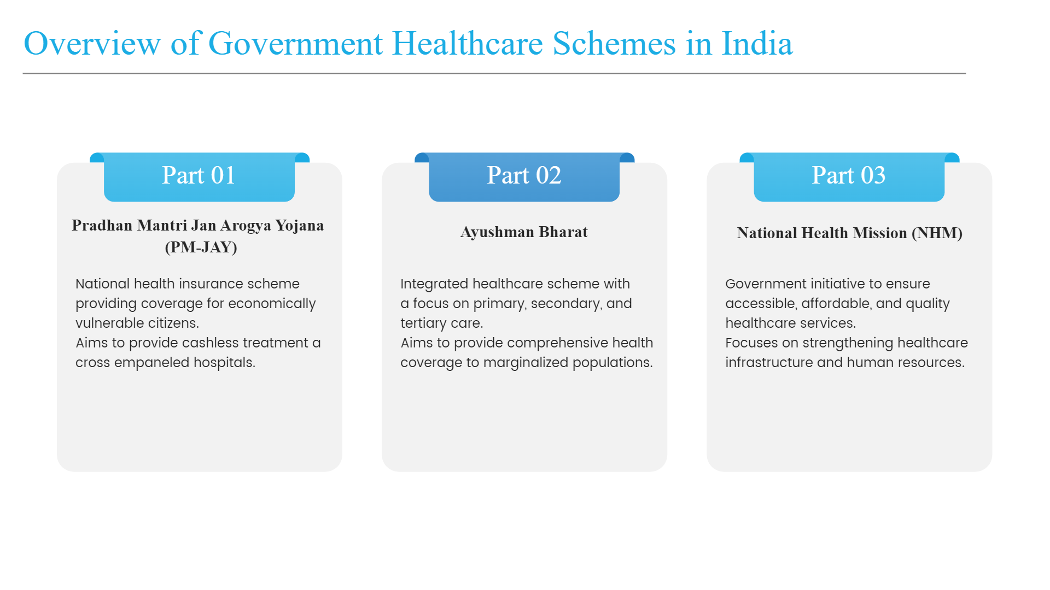

Slide 15
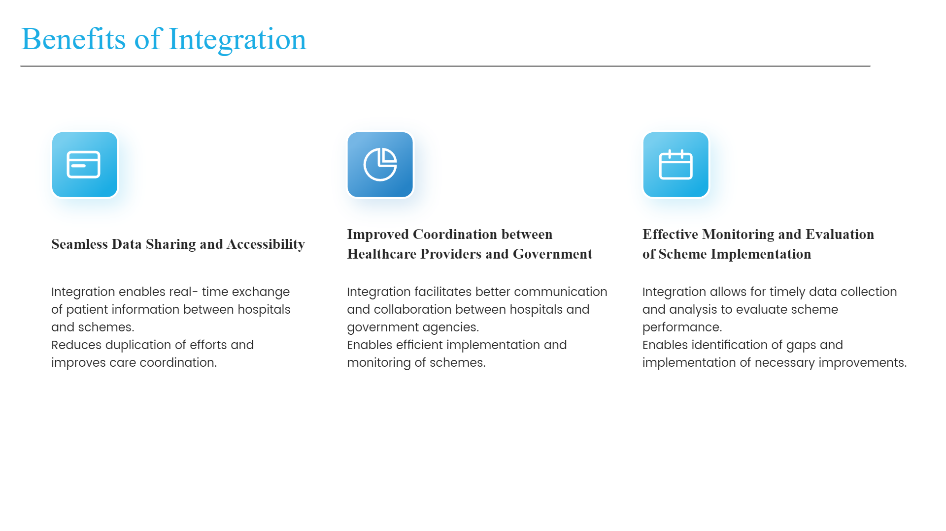

Slide 16


Slide 17
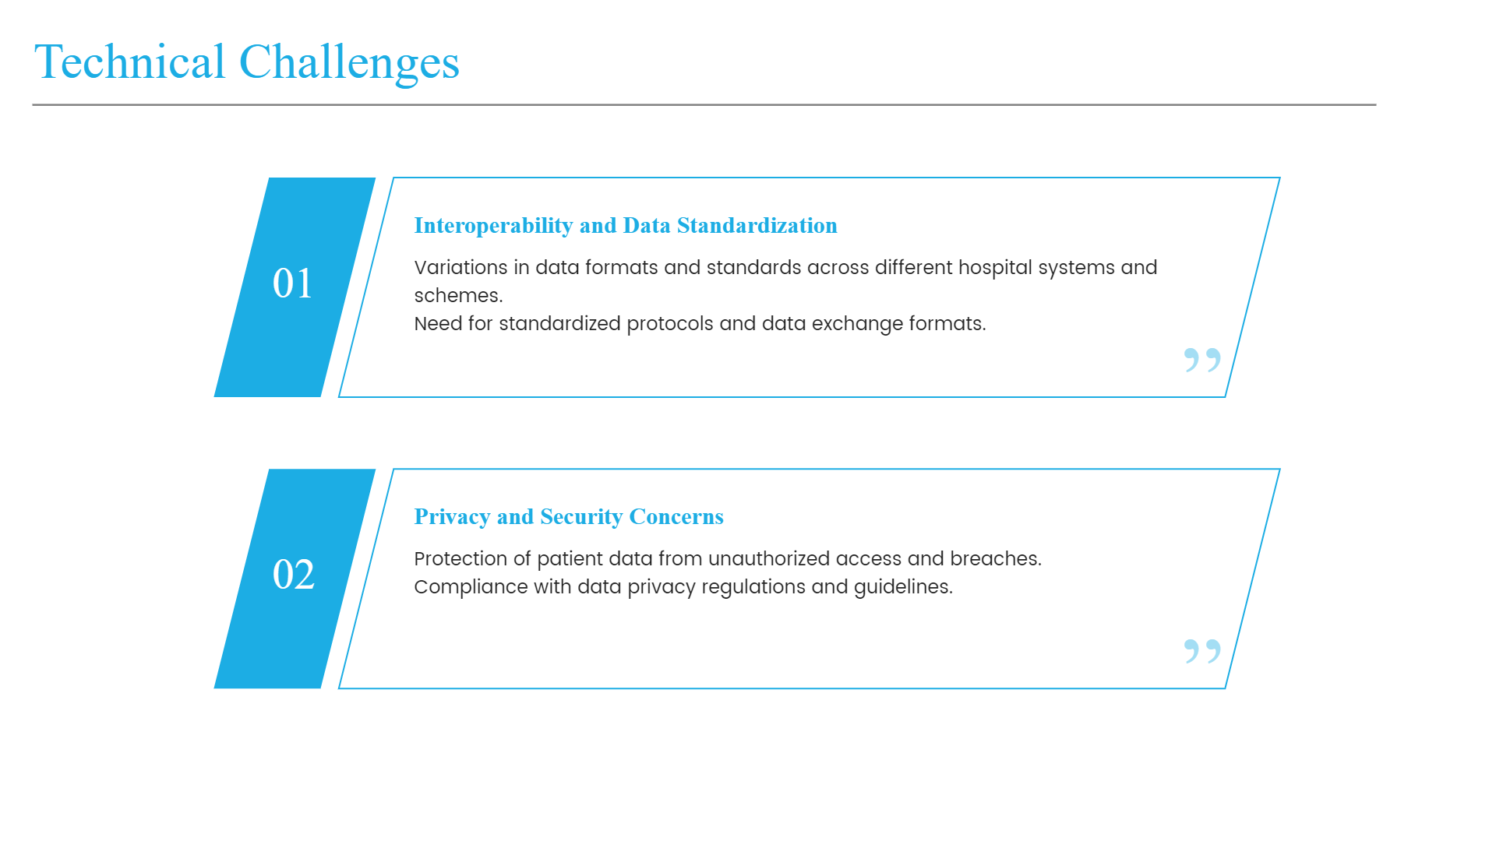

Slide 18


Slide 19


Slide 20


Slide 21
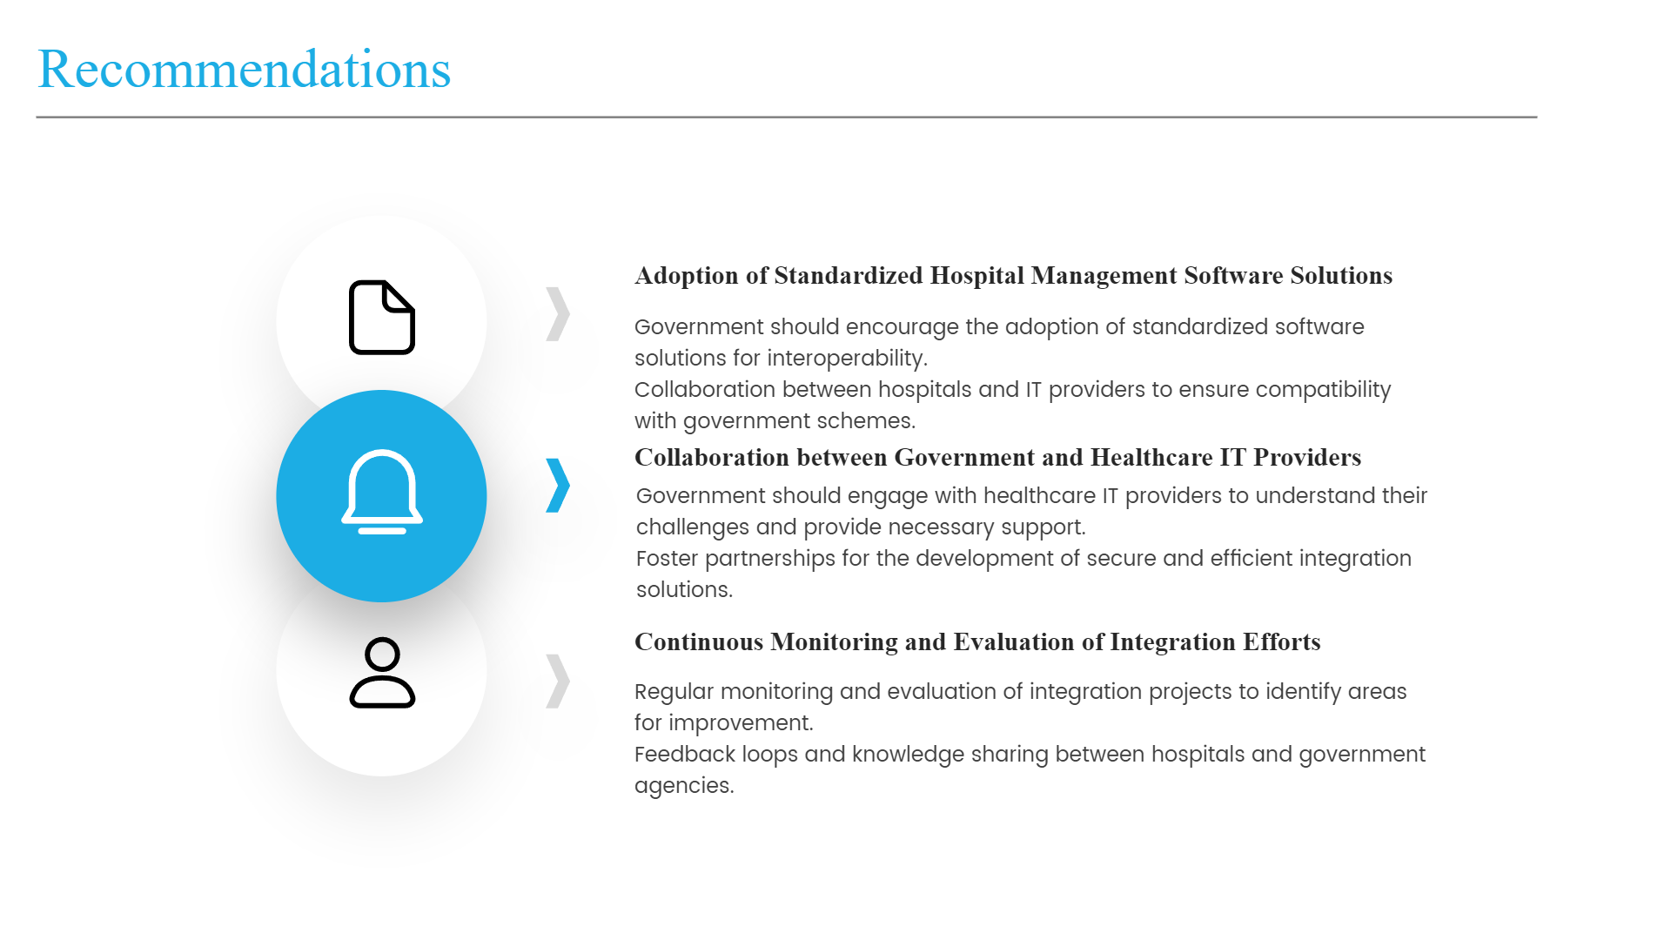

Slide 22

Thank You

