Slide 1



WAREHOUSE
MANAGEMENT SYSTEM
Akhil Trivedi
Director of TMBS group, has been working at CIO level positions for Halma group for 25+ years and has been certified by EC-Council – CEH, (ISC)2 – CISSP, CCSK , ISACA – CISA, MCSE, Cisco – CCNA
www.tmediabusinesssolution.com

Slide 2

ABOUT TMBs
TMBS is a pioneer in web design and development and has been voted as one of the Top 10 service development companies in India. We are a leading IT Consulting and web solution provider in custom software, website, games, web apps, enterprise mobility, mobile apps and cloud-based application design and development. We are ranked one of the fastest-growing web design and IT company globally, with successfully delivered projects across the U.S.A, UK, UAE, Canada and other countries. Over 80% of client retention rate demonstrates our level of services and client satisfaction.

Slide 3

INVENTORY MANAGEMENT
Managing a warehouse and your inventory is an ongoing cycle that never ends as long as you are running a business.
Focuses on overall inventory levels and their status.
Provides information to calculate sales trends, profit margins, and holding costs.
Reorder based on demand and preferred stock levels.
Caps on inventory record.
Tracks the movement and location of stock within the warehouse.
Analyzes sales trends, profit margins, and holding costs.
Reveals opportunities to streamline tasks.

Slide 4

RECEIVING/
In this step, the transferring of ownership of goods is involved, especially financial responsibility by its nature. This ensures the accuracy of the documentation and indicates the availability of the material to the customer as soon as possible. This warehouse management system accelerates the movement of goods received from the receiving process shipping dock to the storage location.
Receiving involves control over the delivery to your warehouse of the correct quantity of the desired product – of the right quality at the right time. This process can in turn be broken into smaller ones:
Preparing space in the warehouse,
Unloading (manual or automated),
Verification,
Filling in the database etc.
At this stage automated dimensions that capture cargo measurements can be helpful as are dock schedulers to ensure that an adequate number of workers are on hand.

Slide 5

RECEIVING AND PUTAWAY
The process is highly sensitive to the warehouse management staff and needs complete accuracy and efficiency to ensure the credibility of the transaction.
QA: Checking the quality of goods received
Damage goods: Confirming the condition of items acquired
Accuracy: Ensuring the quantity of inventory obtained
Space management: Allocating space for the goods in the warehouse
Paperless: Preparing paperwork per shipment
Lot management and Bin Management
Benefits of Put away: Efficient storage of goods, higher safety of products, accurate documentation of goods, better utilization of space

Slide 6
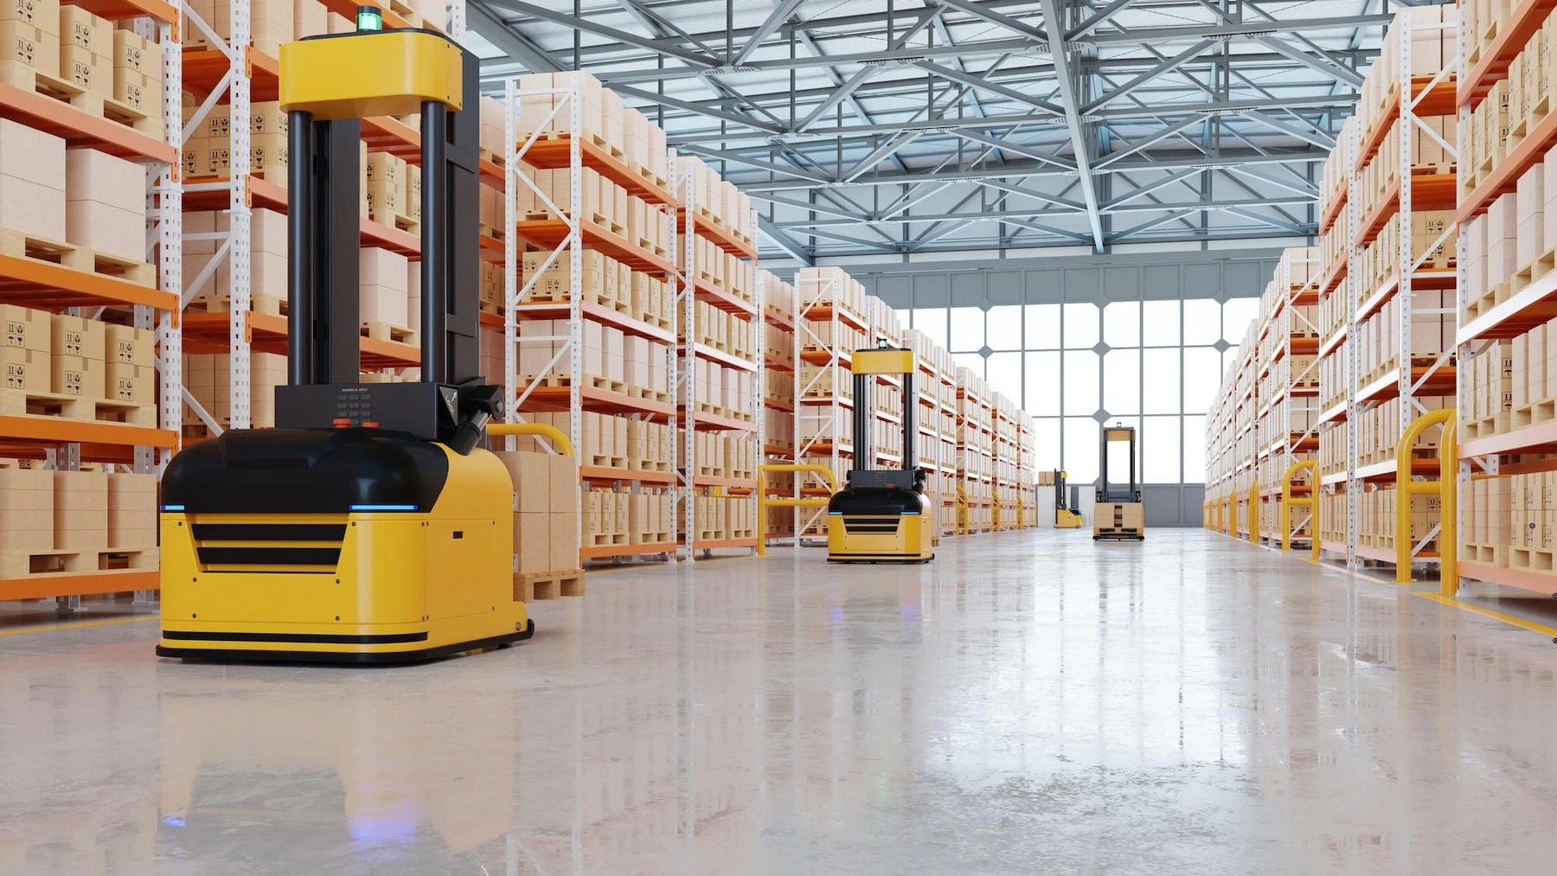
STORAGE
One of the most critical issues that warehouse managers struggle with is optimizing warehouse storage. When not done properly, it can have costly.
Get the Total Warehouse Storage Area
Calculate the Maximum Storage Capacity Based on the Current Setup
Determine the Potential Storage Area Within the Warehouse
Calculate Your Storage Space Utilization
Optimizing the warehouse storage process can require a significant amount of time and money. However, the long-term results it provides will certainly benefit the success of your business.

Slide 7

STOCK LEVEL CONTROL
FIFO and LIFO
Min-Max Inventory Control
JIT Inventory
Two- or Three-Bin System
Fixed Order Quantity
Fixed Period Ordering
Vendor-Managed Inventory (VMI)
Set Par Levels
Properly managing inventory can make or break a business and having insight into your stock at any given moment is critical to success.

Slide 8

CREATING PURCHASE ORDERS
A purchase order (PO) is a legally binding document created by a buyer and presented to a seller. The PO is a list of what the buyer wants to purchase, and it includes the order details. Every purchase order needs to include the following details:.
PO number
Products needed and the quantity of each
Issue Date
Product details (SKU numbers, brand names, model numbers)
Price of each product per unit
Delivery date
Shipping and billing address
Company name & contact info
Terms for payment
At the bottom of a purchase order, place the total order amount (of products), total price, and an authorized signature.

Slide 9
ORDER MANAGEMENT
Order Management is the process that starts when a customer places an order and ends when the order is fulfilled. Order management allows businesses to coordinate the entire fulfillment process. Warehouse managers make use of physical ledgers, manual logbooks, or order management systems to stay on top of order status.
Processing customers’ orders are the key function of any sales-oriented business. Accuracy and speed are crucial to achieving customer satisfaction. There are many ways in which implementing WMSs can help improve efficiency and reduce errors at every stage of this complex process.
Receiving/creating sales orders
Picking & Packing
Shipping
Returns
Invoicing
Product Tracking (Real time tracking)

Slide 10
PICKING
Picking lists can be a pain to create. WMS will let you sort and print lists conveniently, by bin location, order date, SKU, etc. Mobile devices or voice systems can then guide workers to the exact place where the product is stored. If multiple items have to be picked, the optimal route together with the necessary equipment will be suggested to reduce travel time. Barcode or RFID scanners ensure the accuracy of getting the right items. Today, big players like Amazon or Alibaba also use robots in their warehouses and implement other AI technologies.
PACKING
The type and amount of packaging are calculated automatically for every order and the optimal packing procedure is suggested (gift wrapping). The shipping labels for UPS,FedEx, and USPS (as well as price tags, logos, BOLs, and other necessary paperwork) can be printed directly from the system so there is no need to manually enter addresses or retype tracking numbers. Quality control is also simplified as employees have the exact information and standards for every item.

Slide 11



SHIPPING
Packed orders are then shipped to the customer’s address through a chosen carrier that was noted during the verification step. Shipping methods can range can follow multiple methods, ranging from local delivery to overseas shipping in containers.
Rate calculation and real-time parcel tracking are available in most WMSs. If multiple orders are shipped to the same address, they can be merged to reduce shipping costs. Features of cross-docking and drop shipping are also offered by some providers.
RETURNS
Warehouse Management System (WMS) can help streamline this unpleasant process by automating every step: creating the return, recording the reason, updating stock, issuing full or partial refunds, and generating reports

Slide 12

INVOICING
Invoices are created and sent automatically, including individual discounts and payment options for every customer. Normally multiple formats are supported, whether it is email, CSV, or EDI. In particular, a statement of the amount due to a list of goods and services distinguishes an invoice from a bill.
Overall, organizing your orders in one central system provides full visibility of the complete history of every order – payment information, shipping status, staff involved, total time spent, etc. Moreover, giving your customers access to view and manage their orders increases their engagement and trust and encourages future cooperation
PRODUCT TRACKING
(REAL TIME TRACKING)
The tracking method that makes use of GPS as well as logistics databases to determine the current location of a person, vehicle, or object at any moment in time is known as Real-time Tracking. When a parcel is scanned, it is assigned to a vehicle, and its position is constantly monitored.

Slide 13
LABOR MANAGEMENT
When the business is still small and you just have a handful of employees, managing is easy. Scheduling, payrolls, and performance control can be done manually and don’t take long. However, it becomes more complicated as the company grows and the staff becomes more numerous. Most WMSs offer some kind of a labor-management module that can be handy for:
Schedule
Sometimes more people are needed at the docks to unload the incoming shipping quickly and not let the product overstock dock areas, and at other times a big order needs to be collected and packed promptly. Seasonal peaks and valleys also strongly affect labor demand and allocation. Automated schedulers help plan and forecast the exact number of people needed by day, zone, and job type according to your procurement and shipping schedule.
Performance/Activity Tracking (Barcode/ RFID)
Tracking KPIs (i.e., the number of items picked, number of orders packed, travel time, etc.) keeps managers informed, rewards stronger workers, and identifies those not meeting their requirements or needing additional training. Moreover, workers’ engagement increases due to visibility and access to operational results and peer comparisons.
Surveillance
Regrettably, since theft is a regular issue, installing in cameras, sensors, and video surveillance has grown to be a popular fix. By tracking staff locations, detecting the license plate numbers of incoming trucks, limiting access to specific areas, and other methods, integrating a security system with your WMS can help you keep an eye on what precisely is happening in the warehouse.

Slide 14


FINANCIAL MANAGEMENT AND REPORTING
Monitoring business performance and sales trends across locations, customers, and products are mandatory for making informed, data-driven decisions about future actions and developments. WMS offers numerous opportunities to track and generate reports concerning every side of your business.

Slide 15

INTEGRATION WITH OTHER SOFTWARE (CUSTOMIZATION)
Customizable metrics let you assess all the data and know your most profitable customer, top-selling product, best-performing sales channel, most efficient worker, peak sales season, etc.
Automatic balance sheet accounts for revenue, taxes, and the cost of products sold based on real-time data saves time, and minimizes miscalculations. Many WMSs support multi-currency pricing, different tax systems, and landed cost management, which is crucial if you operate in multiple locations.
Integration with accounting platforms we can develop with your requirements is also a common feature to have all accounting in one place.

Slide 16

CLOUD-BASED ERP
A cloud-based WMS refers to a facility with warehouse management. With a 100% web-based interface, it can be accessed from any device via an internet connection. External servers are used to run and store the program data, so the business doesn’t need to store
any hardware on its premises. This contracting mode is swiftly overtaking the on-premise model, whereby the system is installed on a server hosted by and contained within the company itself.
Key features
Having a SaaS WMS brings multiple benefits, namely:
100% cloud-based. All information and data generated in the facility are captured and stored in the cloud utilizing cloud computing.
Multiuser. Companies can increase or reduce the number of licenses based on their workload and product demand.
Multi-device. The software can be accessed from any computer or portable device (tablet or smartphone) with an internet connection.
In real-time. Warehouse inventory is continuously updated, e.g., whenever a product is received and stored and an order is prepared and sent to a customer.
Scalable. The software features can be adjusted, modified, and expanded according to the company’s needs to adapt to business growth and fluctuations. Secure. There’s no risk of accidental data loss since backups are made automatically.

Slide 17

CONTACT US
Location
Phone Number
+1 908-334-4476
India
USA
Canada
Belize
Email
info@tmediabusinesssolution.com
at@tmbsusa.com
sp@tmbsusa.com
Web
www.tmediabusinesssolution.com
Demo: https://ware.onlineedification.com/

